Slide 1

Tomie dePaola
Author and illustrator
By: Sabrina Page, Sarah Pruett, Lauren Testino

Slide 2
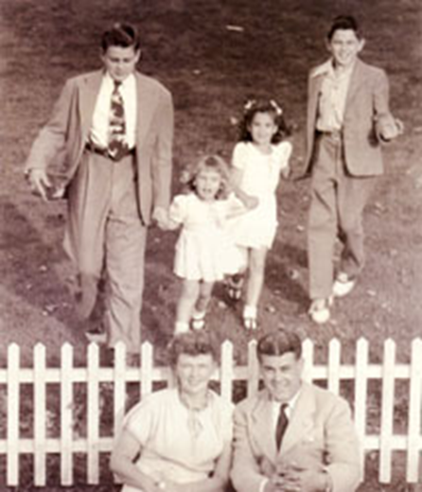
childhood
Born on September 15, 1934 in Meriden, CT
1 brother and 2 sisters- Joseph, Judie and Maureen
Mom read to him at an early age
When he grew up he wanted to…write stories and draw pictures for books and to sing and tap dance on stage

Slide 3
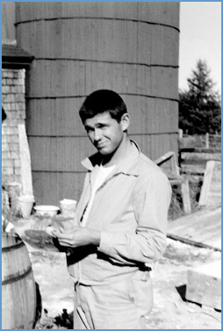
Growing Up
Took dance and art classes
Created art for exhibitions, theater productions, and posters
Graduated from high school and went to Pratt Institute in Brooklyn, NY
Learned to draw everything

Slide 4

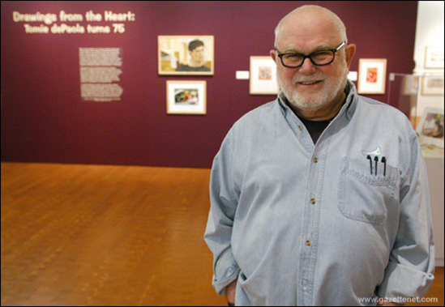
Didn’t get a contract for his first book
His first job was to illustrate a science book called Sound
Wrote and illustrated his first book a year later The Wonderful Dragon of Timlin
Illustrated nearly 250 books, written over 100 stories
Works in a studio attached to a renovated 200 year old barn in New Hampshire

Slide 5

Random Facts about dePaola
Favorite Color: White
Favorite Food: Popcorn
Favorite Holiday: Christmas
Age: 76
Why hearts: It’s shorthand for “love”
Hobbies: Cooking, reading, gardening, traveling, watching movies, shopping

Slide 6




Books
18 of his books are autobiographical.
There are 11 Strega Nona books
dePaola’s favorite book of his: Nana Upstairs, Nana Downstairs
Over 15 million copies of his books have sold worldwide
His books have been translated into 25 different languages

Slide 7


Awards
1976 Caldecott Honor for Strega Nona
1982 Golden Kite award for Giorgio’s Village
1999 Living Treasure New Hampshire Governor’s Arts Award
2000 Newbery Honor for 26 Fairmount Avenue
2003 Lifetime Achievement Award- New Hampshire Writers’ Project
2011 Laura Ingalls Wilder Award

Slide 8
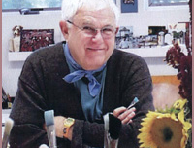
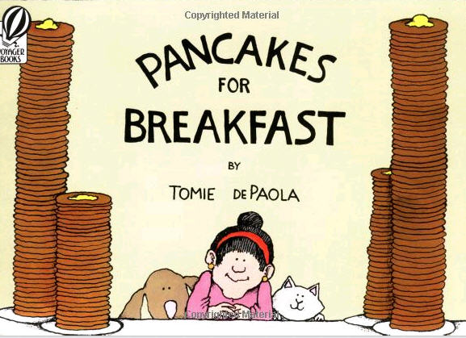

http://www.youtube.com/watch?v=7epT0qUaaX4
http://www.youtube.com/watch?v=aGfK26oDhY4

Slide 9
Tomie dePaola’s work
IS…. | IS NOT….
Cultural | Limited in age range
Soft colors (water color, pastels) | Rhyming
Family | Complex Vocab
Religious | Bland
Hearts (Hidden) | Black and white
comical
Contain a lesson or morale

Slide 10
Sources
www.tomie.com
http://www.tomiesblog.blogspot.com/
http://www.tomie.com/books/bibliography.html

